Slide 1

COVID-19 PREDICTION
CS 451 FINAL PROJECT
TEAM: Mike Zhang (TW4ZHANG), Xinkai Li (X638LI), Claudia Ying (NYING)
Notes:
Covid-19 prediction

Slide 2
Idea
Notes:
the idea

Slide 3
Use Twitter data to improve the performance of an epidemiological model like SIR to predict the future covid-19 infection case
Notes:
Our idea is to use Twitter data to improve the performance of the SIR model to predict the future covid-19 infection case

Slide 4
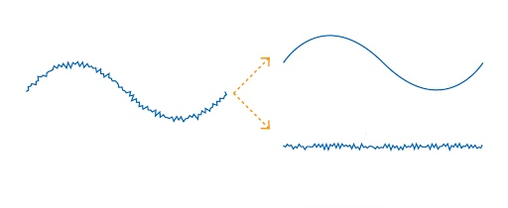
Why Will it Work?
SIR model
Adv.: simple, reasonably predictive
Dis.: over-simplified
Fluctuations
Events such as quarantine, border closure.
Twitter
OBSERVED
SIR
Fluctuations
Notes:
SIR model is good at explaining and predicting the trend of an epidemic like COVID-19 in the big picture. It gives a reasonable prediction with a simple implementation.
However, the SIR model is over-simplified and it can only give a smooth prediction which means it is hard to explain the fluctuations which come from all kinds of events, such as quarantine and border closure.
As one of the most popular social media, Twitter gives a direct revelation of people’s reactions to some important events related to COVID-19. For example, when social distancing rules are getting enforced in Canada, words like ‘stay at home’ or ‘lockdown’ become popular topics discussed on Twitter.
Therefore, in this project, we will use SIR as a base model, combined with the Twitter data to build a more powerful prediction model.

Slide 5
Methodology
Notes:
Methodology

Slide 6
SIR Model
+
Twitter Model
Machine Learning
Combined Model
Notes:
The methodology is basically made of three parts, the SIR model, Twitter model and a combined model built up with machine learning based on the previous two models.

Slide 7
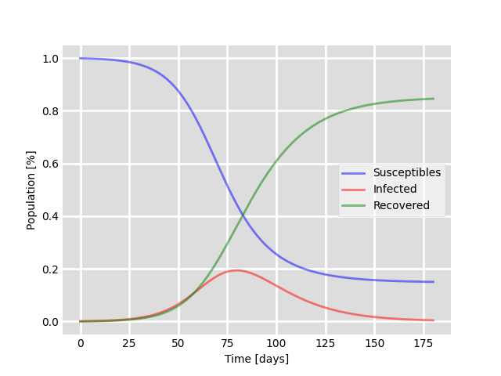
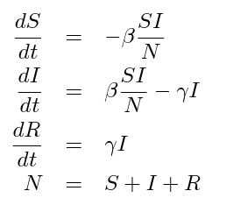
SIR Model
3 differential equations
susceptible (S), infected (I), and resistant (R).
Notes:
SIR model is an epidemiological model that computes the theoretical flow of the susceptible people, the infected people and the recovered people. Its core algorithm is 3 differential equations as the slide shows. The parameters beta and gamma partially control how fast people move from being susceptible to infected, and from infected to resistant.

Slide 8

Twitter Significant Word Extraction
(March 4 to March 31) && (English)
8 Million
Tweets
Tokenize
Normalize
Stop Word
Lemmatize
Stem
Unigram &
Bigram
BOW
Top 20 words having strongest correlation with # of new cases
Calculate Correlation
1000 most frequently occurred Unigrams/Bigrams
Notes:
In order to take into account fluctuations, we use Twitter data to generate a language model extracting the most influential topics. We tokenize, normalize and massage the filtered data to get the top 1000 most frequent keywords. Calculate their correlation with confirmed cases. Observed that there are positive and negative correlated keywords. We take the absolute value and filter out the top 20 as significant words and convert them into vectors using bag of words.

Slide 9
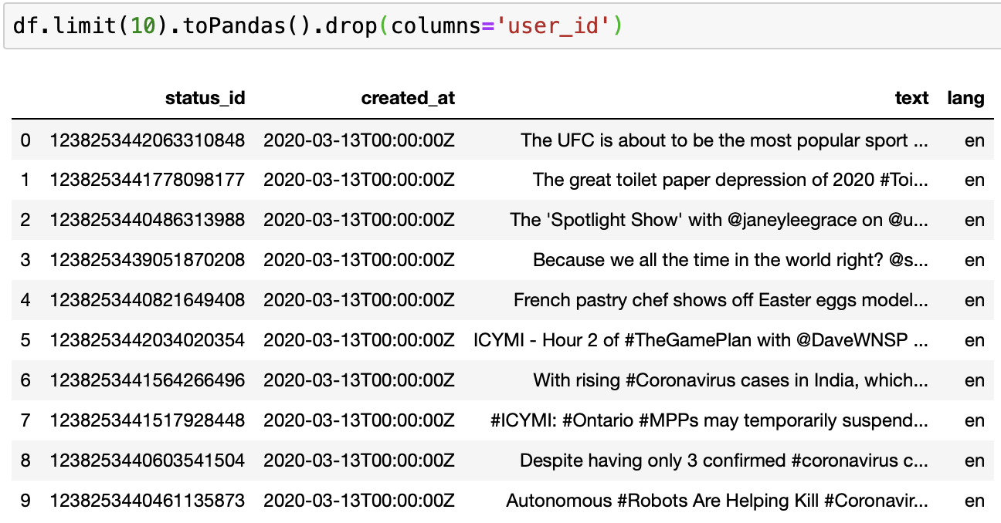
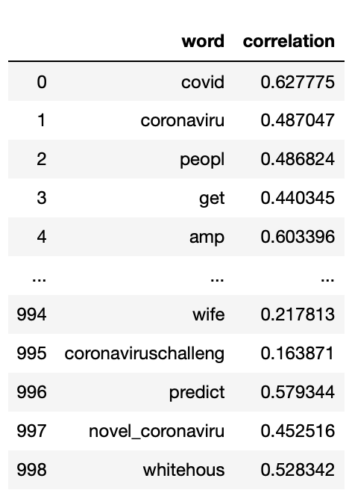
… Like This
Notes:
The data processing is something like this.

Slide 10
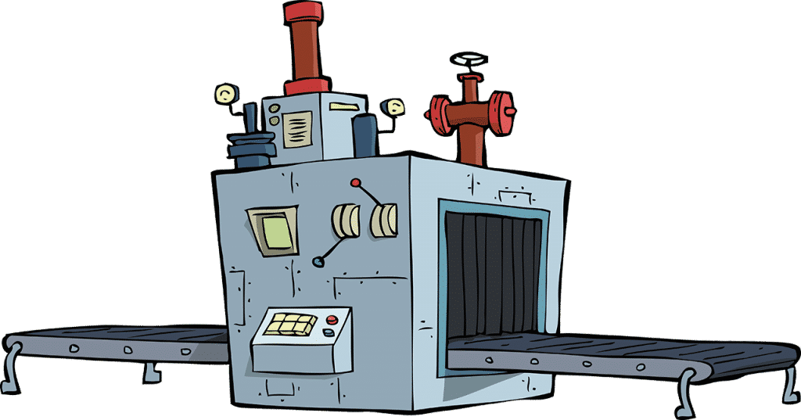
ML Combination
+
Simple
Linear
Regression
Final Model
Notes:
Finally, we consider the result from the SIR model and the 20 most significant words as features to a machine learning model like linear regression. We let the machine itself balance those features weights and finally apply L2 regularization to avoid overfitting.

Slide 11
Implementation
Notes:
2s

Slide 12
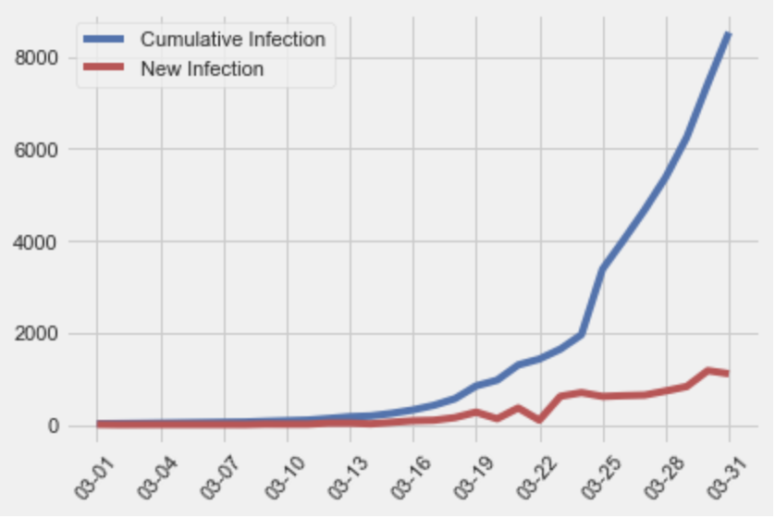
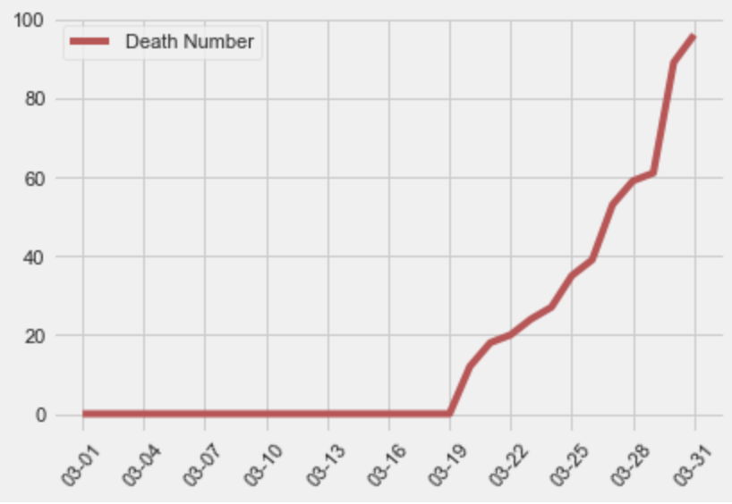
Which Data to Use?
Data about covid-19 from www.canada.ca
# Confirmed, Susceptible, Recovery cases for covid-19 from March 4 to March 31st
Population of Canada
Tweets
Hashtag #Covid19, #Coronavirus, etc
~40M Tweets from March 4 to March 31st
~8M Tweets known to be in English
Notes:
For data source, we get a csv file about covid-19 from the government official website.
We also download 40 million Tweets online, and use spark SQL to filter out English ones.
Now, let’s talk about the model implementation.

Slide 13



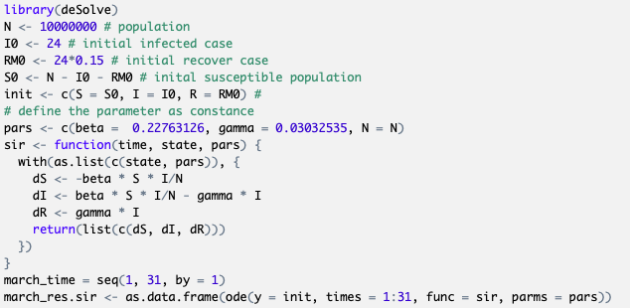
SIR Model Implementation
Clean using Spark SQL
Using least square method to determine the parameters for SIR
Solve ODEs for SIR model using deSolve library
Optimize parameters using nlminb function
Use the SIR model to make analysis and predictions
Clean
Solve
Notes:
We use Spark SQL to clean the plain data. For the R implementation part, we build up the differential equations for the SIR model. Then we use non-linear minimum optimization function in R to find the best parameters which produce the smallest squared error. Finally, we use the optimized SIR model to make the prediction.

Slide 14



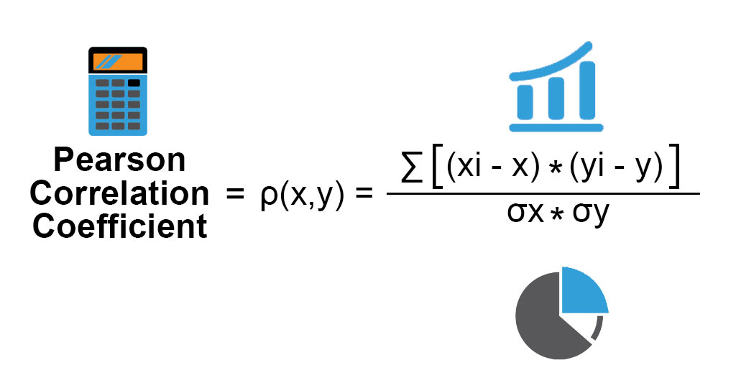


Twitter Model Pipeline & Implementation
Download
Process
Transform
Store
Calculate
Notes:
Tweets are downloaded in a series of csv files and loaded to a Spark SQL Dataframe to perform some simple filtering steps. We then use the Spark ML and Spark NLP libraries to preprocess the textual data. (Spark NLP module has great preprocessing functionalities like tokenizer, and Spark ML has a pipeline framework making everything scalable.) We then vectorize the textual data and calculate correlations using Spark SQL functions and finally save everything as parquet files in HDFS.

Slide 15
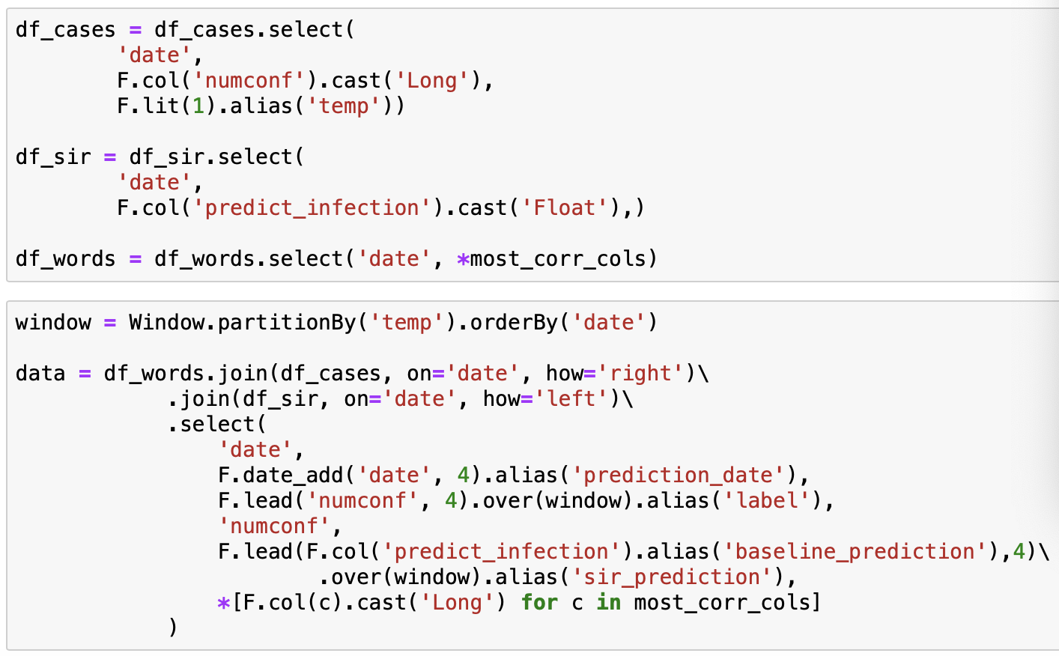
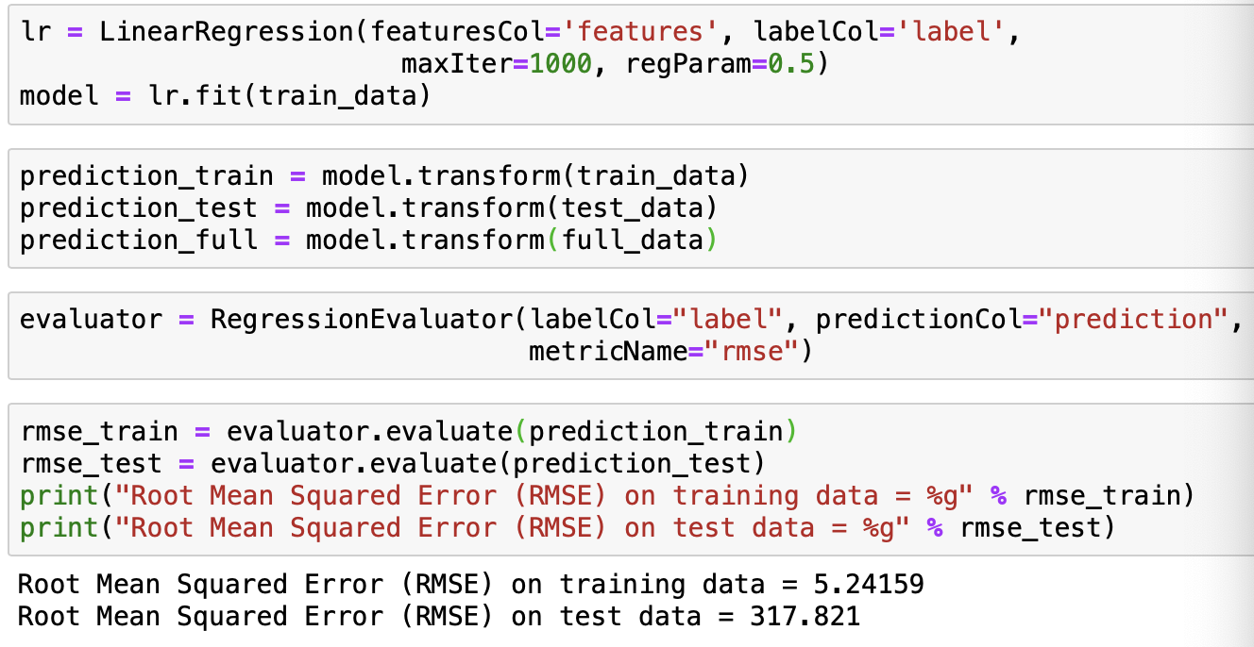
Final Model Implementation
Spark SQL to combine all data
Spark ML to train a Linear Regression model
Notes:
For the combined model, we use Spark SQL to combine all data together and use Spark ML library to train and evaluate a Linear Regression model.

Slide 16
Result
Notes:
result

Slide 17
Predicted Results Comparison
 | April 01 | April 02 | April 03 | April 04
SIR (baseline) | 10863 | 13228 | 16107 | 19611
Combined SIR + Twitter | 9237 | 10932 | 12951 | 14598
True Data | 9595 | 11268 | 12519 | 13882
Notes:
Here is the table of the real data and the predicted results for each model. Clearly, we can observe that the results made by baseline model is a bit off compare to the combined model. For example, the prediction of April 3 for the combined model is about 10 times more accurate than the baseline.

Slide 18
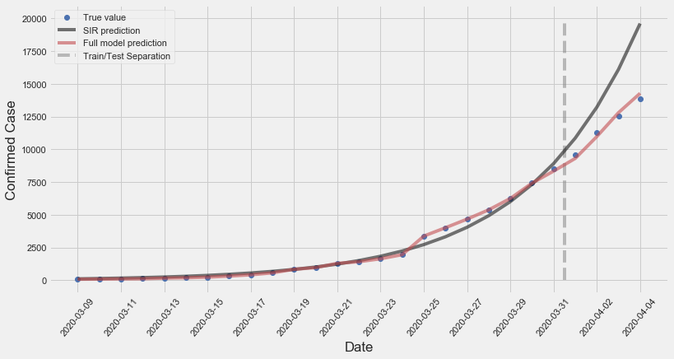
Let’s Draw Them Together
Training
Test
Notes:
From this graph, we can find that although the SIR model fits the training data very well, it heavily overestimates the infected cases in early April, which may be caused by the fact that the Canada government has taken measures such as social distancing and border closure in late March, which slows down the spread of the virus.
With the assistance of tweet data, the combined model considers the influence of social opinions and adjusts the prediction accordingly.

Slide 19
How Good is Our Model ?
 | RMSE |  | MAPE
Data | Train | Test | Train | Test
SIR (baseline) | 290.425 | 3575.761 | 25.892% | 25.134%
Combined SIR + Twitter | 78.339 | 484.970 | 3.238% | 3.830%
RMSE: Root Mean Squared Error
MAPE: Mean Absolute Percentage Error
Notes:
As a result, the combined model has a MAPE of 3.8% compared to 25% for the baseline model. There is also a great RMSE improvement compared to our baseline model.

Slide 20
Some Other Insights
The model is good for prediction window of 1-7 days
4th-day prediction is the best
Possible reasons:
Social media has short-term effects
A delay in receiving COVID-19 test results
The baseline model is not good enough
Advice: STAY AT HOME!
Notes:
We have tried varying the range of prediction windows. It seems that this model is good at making predictions within 7 days. Particularly, the 4th-day prediction generates the best result. The reason for this could be that social media effects are short-term, or it could be that there is a delay in receiving the test results, or it could be simply because the baseline model is not powerful enough, we need something better than SIR.
Finally, hope you guys stay safe and be happy!

